Slide 1


Methods for isolation of single cells
Dean Franckaert
Translational Immunology (Dr. Liston)
VIB and University of Leuven

Slide 2
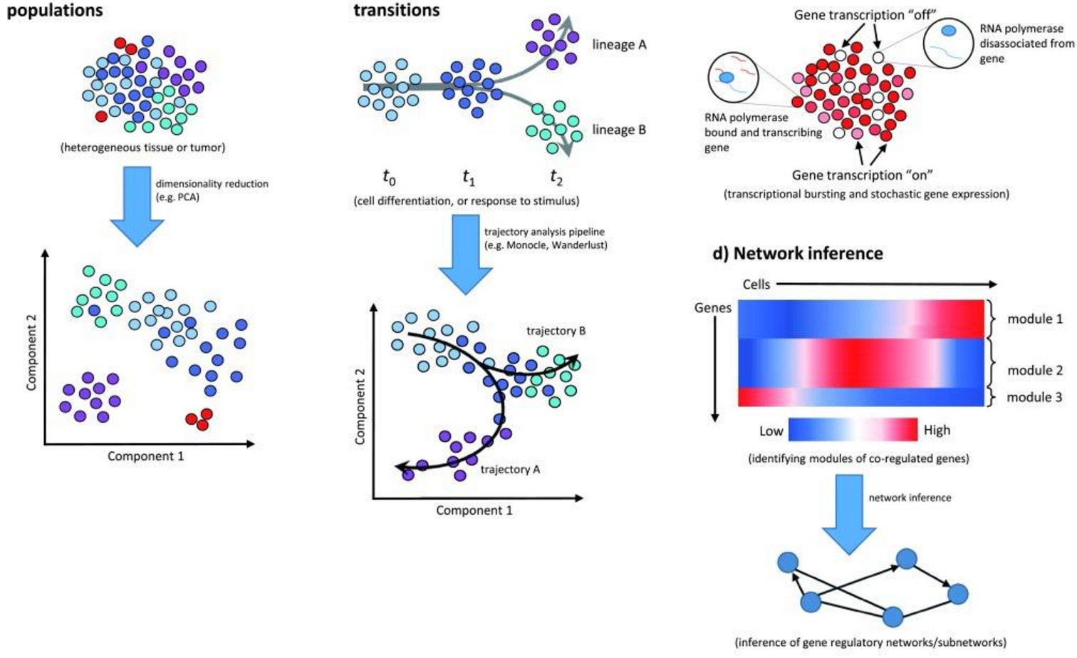
Average response of the population versus singe cell behavior
Liu et al. F1000Res 2016

Slide 3
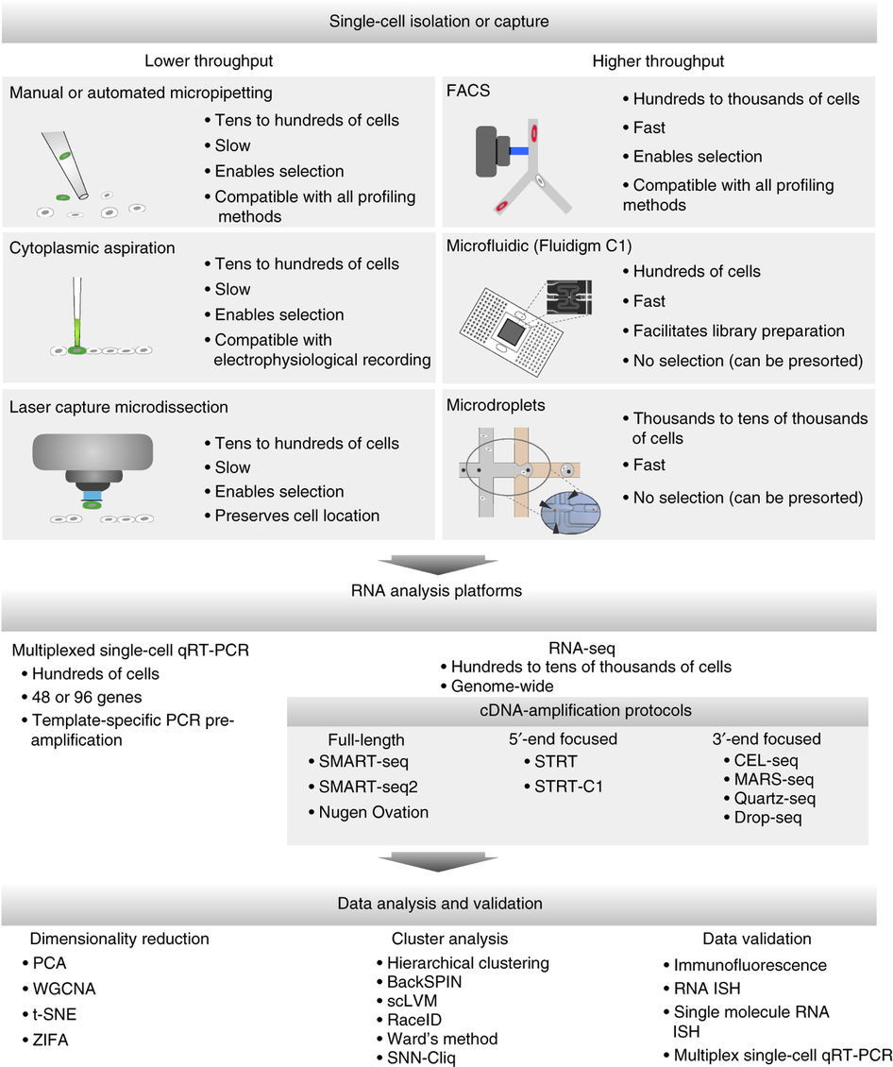
Efficiency versus throughput or throughput versus cost?
Poulin et at. Nat Neuro 2016

Slide 4
Poulin et at. Nat Neuro 2016

Slide 5
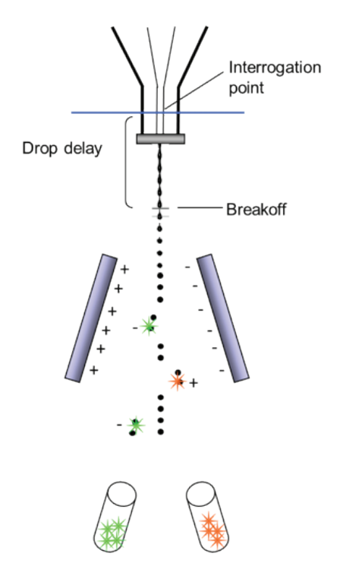
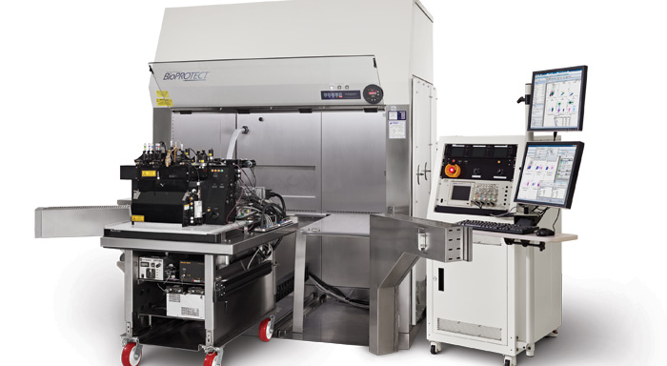
Fluorescence Activated Cell Sorting (FACS)
BD, BD Influx

Slide 6
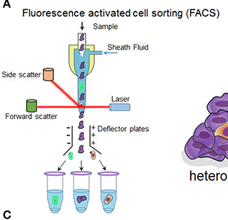
Fluorescence Activated Cell Sorting (FACS)
Typical single-cell isolation:
physical properties (size, density,…) versus biological phenotype (biomarkers)
Fluorescence Activated Cell Sorting (FACS) can select cells on:
Size
Granularity
Numerous markers based on fluorescence (e.g. antibody labeling surface and intracellular, Ca2+ sensitive dyes, proliferation dyes, viability dyes, cytokine capture,…)
or tag in vivo (e.g. GFP-tag, proliferation, RNA probes,…)
Sort bulk populations of single cells straight into plates
Relatively easy to use when compared to microdissection and microfluidics approaches
Hu et al.Front. Cell Dev. Biol.2016

Slide 7
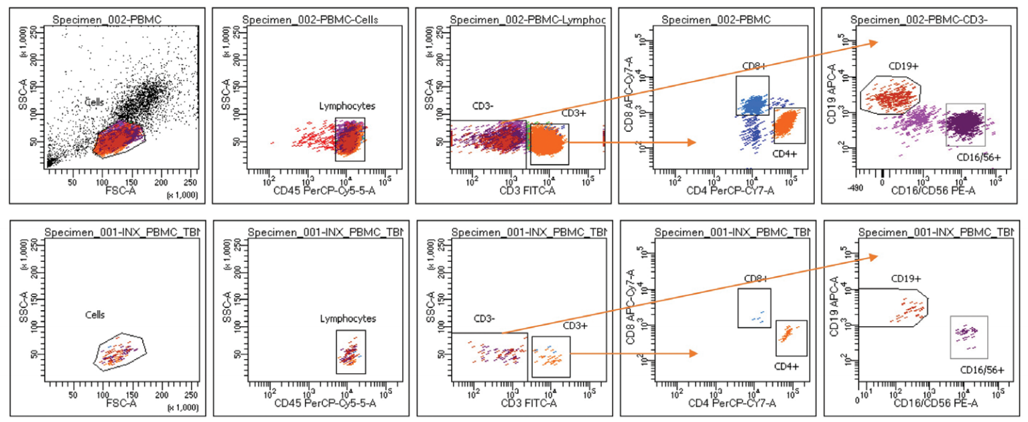
Fluorescence Activated Cell Sorting (FACS)- antibody labeling
Pre-sort
Post-sort
Purity QC

Slide 8
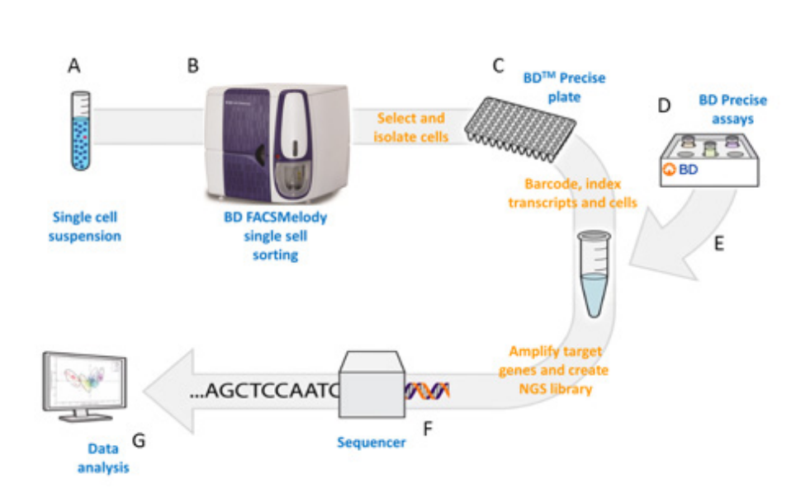
Fluorescence Activated Cell Sorting (FACS)
Multiparameter flow cytometry combined with simultanuous sorting of 1-6 populations for analysis of bulk populations
Analysis of cells at 70000 cells per second (with up to 18 parameters)
Sorting of cells at 5-10000 cells per second in bulk populations
Sorting of cells into 96 or 384 well plates with near 100% purity!
WORKFLOW
Single cell suspension is prepared and stained with antibodies for surface marker and/or viability dyes.
Cells are sorted and analyzed unbiased or based on desired markers into 96 or 384 wells
Continue with library preparation protocol of choice
e.g. PBMCs
Dissociated healthy tissues
Dissociated cancer tissues

Slide 9
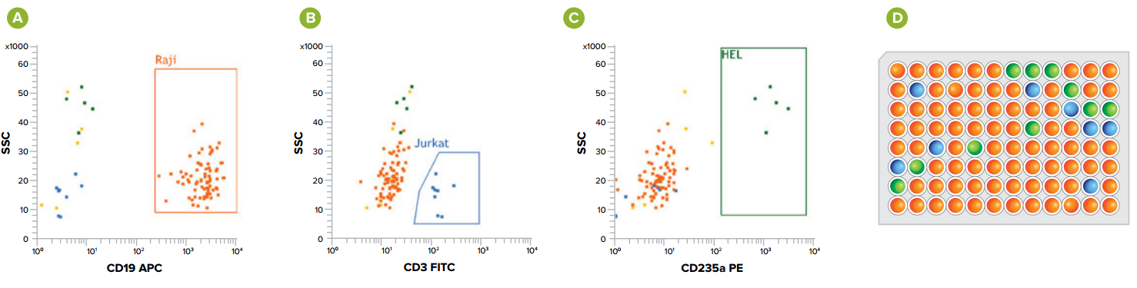
Track cellular identity with INDEX sorting
Size
Granularity
Viability
RNA expression
Cytokine production
Surface biomarkers
Any fluorescent reporter system
Single cell sort into 96 or 386 well plates but MAINTAIN CELLULAR IDENTITY information:
up to 18 parameters including cell size and granularity
Link RNA expression with protein measurement to:
Resolving heterogeneity; capturing individual fluorescence data for each parameter for each single cell collected
Helps to resolve viability gates; testing colony forming potential based on intensity of viability markers
Allows high-throughput resolution of sorting gates; i.e. assessment of individual markers for impact on cell proliferation and differentiation

Slide 10
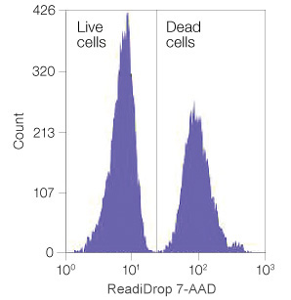
Sample preparation for single cell sorts for sequencing analysis
Requirements for single sorts:
True single cell delivery. Exclude doublets, triplets and DNA-carryover.
Up to date QC, excessive cleaning protocols and proper gating strategy for size exclusion. Adjust gating mask.
Maintain viability and integrity of sorted cell.
Extraction/dissociation to lysis as fast as possible
Adjust sample and sheath pressure to robustness of cell.
Adjust sheath and media requirements to needs of the cell.
Adjust the sorting stream to hit the well in the exact bottom with low (>=2,5ul) volumes.
Death cell exclusion with viability/nucleic acid stains.
Input and output sample temperature controlled

Slide 11
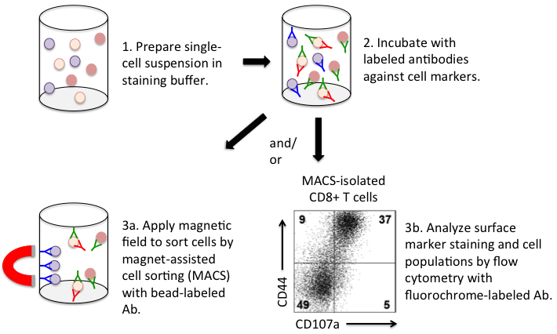
Magnetic-activated cell sorting as cost-effective alternative or add-on to FACS
Similar to FACS
start with single cell solution labeled with antibodies against markers of choice.
Bead-based isolation of cells
positive or negative selection (antibody affinity based)
Purity generally lower than FACS (>95%)
Still external QC step (e.g. flow cytometry)
No direct plate sorting possible
Often used as enrichment step for FACS
Reduce sorting time
Cost-effective
Labome

Slide 12
The high-end Influx for complex or L2 sorts
BD influx
Housed within class II biosafety cabinet for sorting infectious samples
Equipped with small particle detector particularly suited for analyzing nuclei, exosomes and particles as small as 200nm
Index sorting feature allows review of complete phenotype of every cell sorted into plates; each sorted event is “indexed” one-by-one according to the specific well location on the plate allowing post-sort tracking of individual characteristics of each cell
Can sort up to 6 separate populations simultaneously (current systems can only sort 4)
4 lasers and 16 fluorescent parameters

Slide 13
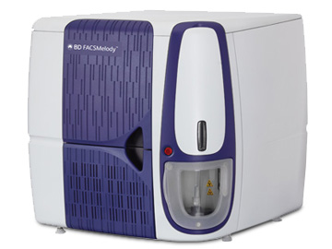
The accessible FACSMelody for unassisted use
BD FacsMelody
Training available for unassisted sorting; automated QC/QA procedures, system ready in less than 15 mins
Cheaper sorting option for simple sorts (i.e. viable single cell sorting, few markers, reporters GFP+/-)
3 lasers (blue/red/violet), 9 fluorescent parameters
Can sort 2 populations simultaneously
Indexed Single cell sorting into plates
Contact info CORE

Slide 14
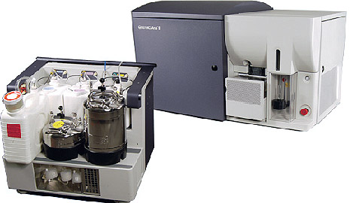
The FACSAria IIu and III for assisted single cell sorts
BD FACSAria IIu and III
Can sort 4 populations simultaneously
2-3 lasers (blue/red/near UV), up to 12 parameters
No index option available

Slide 15

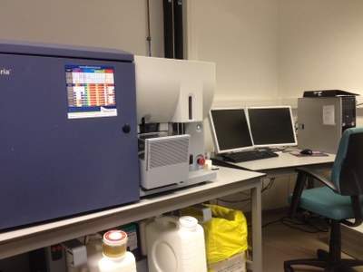
KULEUVEN FACS CORE
Translational Immunology (Dr. Adrian Liston)
VIB and University of Leuven

